Slide 1
UNIT 14 WHAT HAPPENED IN THE STORY?
Lesson 3

Slide 2
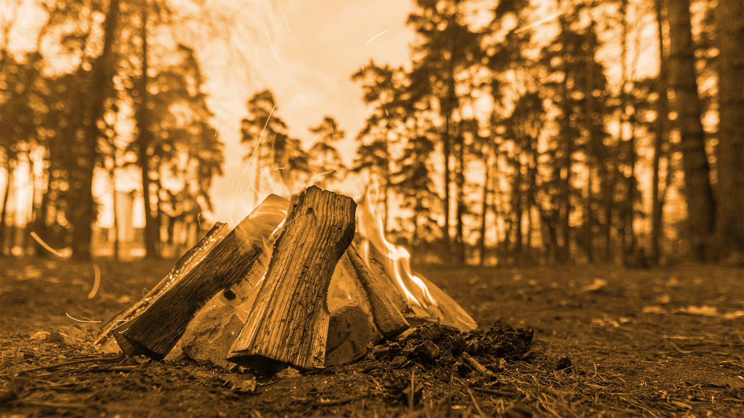
READING TIME!

Slide 3
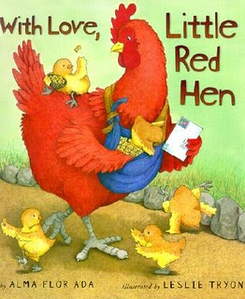
Once upon a time,
there was a Little Red Hen.

Slide 4
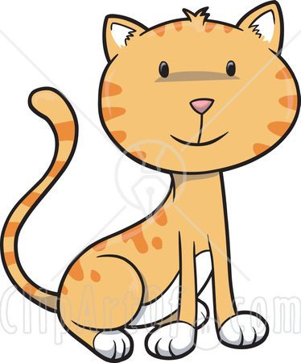
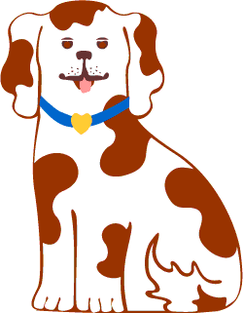
The Little Red Hen had three friends.
They were the cat, the dog and the duck.

Slide 5
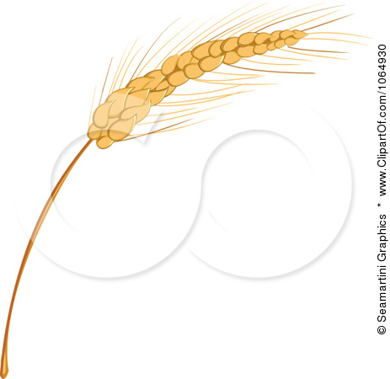
The Little Red Hen found some grains.
Then, she asked, “Who will plant the grain ?”

Slide 6
“Not I,” said the cat.

Slide 7
“Not I,” said the dog.

Slide 8
“Not I,” said the duck.

Slide 9
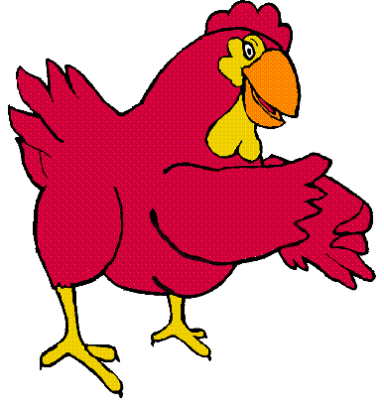
“Very well then, I will”, said The Little Red Hen.

Slide 10
The grain grew into tall wheat.
The Little Red Hen asked,
“Who will cut the wheat?”

Slide 11
“Not I,” said the cat.
“Not I,” said the duck.
“Not I,” said the dog.

Slide 12
“Very well then, I will”, said The Little Red Hen.

Slide 13
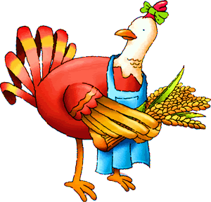
The Little Red Hen cut the wheat.
Then she asked, “Who will bake the bread?”

Slide 14
“Not I,” said the cat.
“Not I,” said the duck.
“Not I,” said the dog.

Slide 15
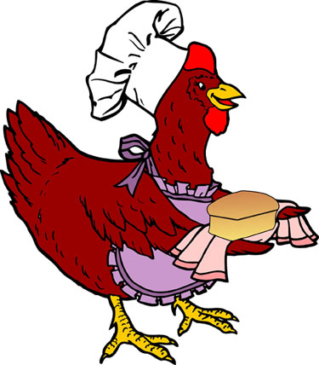
So, The Little Red Hen baked the bread.
Then she asked, “Who will eat the bread?”

Slide 16
“I will,” said the cat.
“I will,” said the duck.
“I will,” said the dog.

Slide 17
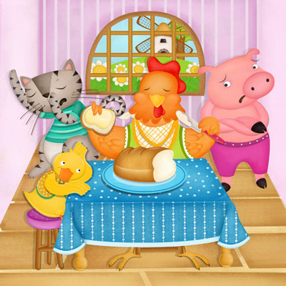
“Very well, let’s share the bread !” said the Little Red Hen.

Slide 18
DISCUSSION!
What do you think of the cat, the dog and the duck?
What do you think of The Little Red Hen?
What does the story teach you?

Slide 19
UNIT 14 WHAT HAPPENED IN THE STORY?
Lesson 3

Slide 20
5. Reorder the sentences to make a full story then answer the questions. (p.15)
7
4
6
5
2
8
3

Slide 21
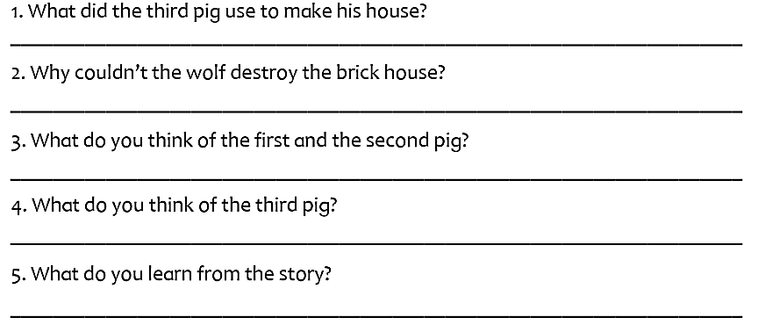
5. Reorder the sentences to make a full story then answer the questions. (p.15)
He used bricks to make his house.
The house was very strong.
They were not very smart.
He was smart to use bricks to build his house.
You should think before you do something.

Slide 22
1. What to include in a fairy tale? Fill in the gaps using the words in the box. (p.16)
Once upon a time
First
After that
Next
In the end

Slide 23
2. Use the tips in Exercise 1 and write your own fairy tale. (p.16)

Slide 24
THANKS FOR YOUR ATTENTION!

